Slide 1

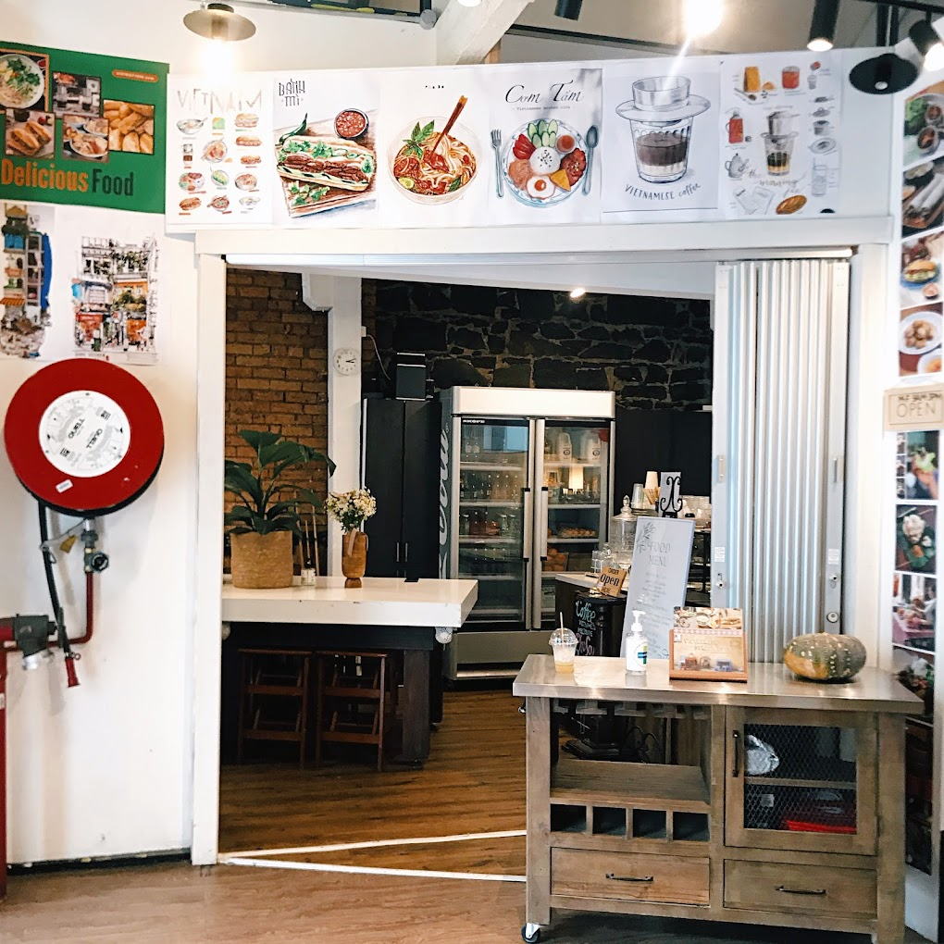

Introduction
Vietboy1996 is a Vietnamese coffee shop located near the Southern Cross station, renowned for its visually appealing store design and delectable Vietnamese cuisine. With a loyal customer base comprising mostly office workers, the cafe has established a strong online presence through food delivery platforms like Doordash, Uber Eats, and MenuLog.
However, the business has been facing financial challenges due to an increasing number of remote-operated businesses locally and frequent slow-downs in their online sales.

Slide 2
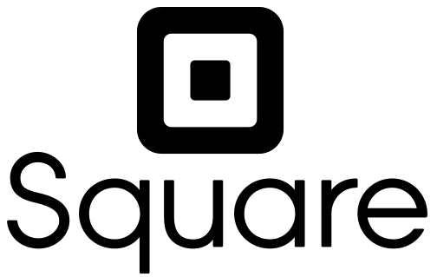
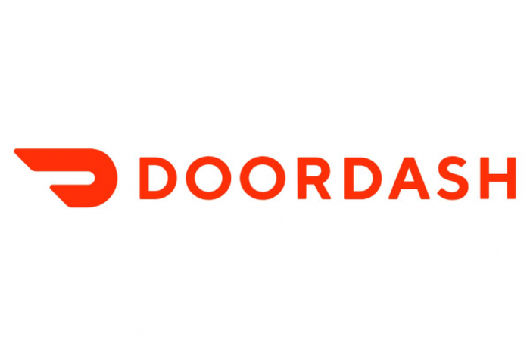
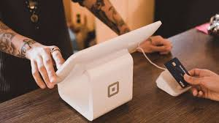


Business and Technology sectors
Accordingly, the small café is partnered with Square, which is an online platform that provides the POS software.
On top of that, they also employ tech sector delivery services such as Menulog and Uber Eats as their only availed food shipment method
Third-party service providers including software and delivery take high surcharge on storefront, which insinuating a general reason for the remarkable downgrade in profit and result in the store's contemporary financial difficulty situation.
Behind the revolution

Slide 3

Process Identification
The process that has been identified is sales
Sales for this business is a critical element as it is the primary revenue source
Each team member has interacted with this process

Slide 4
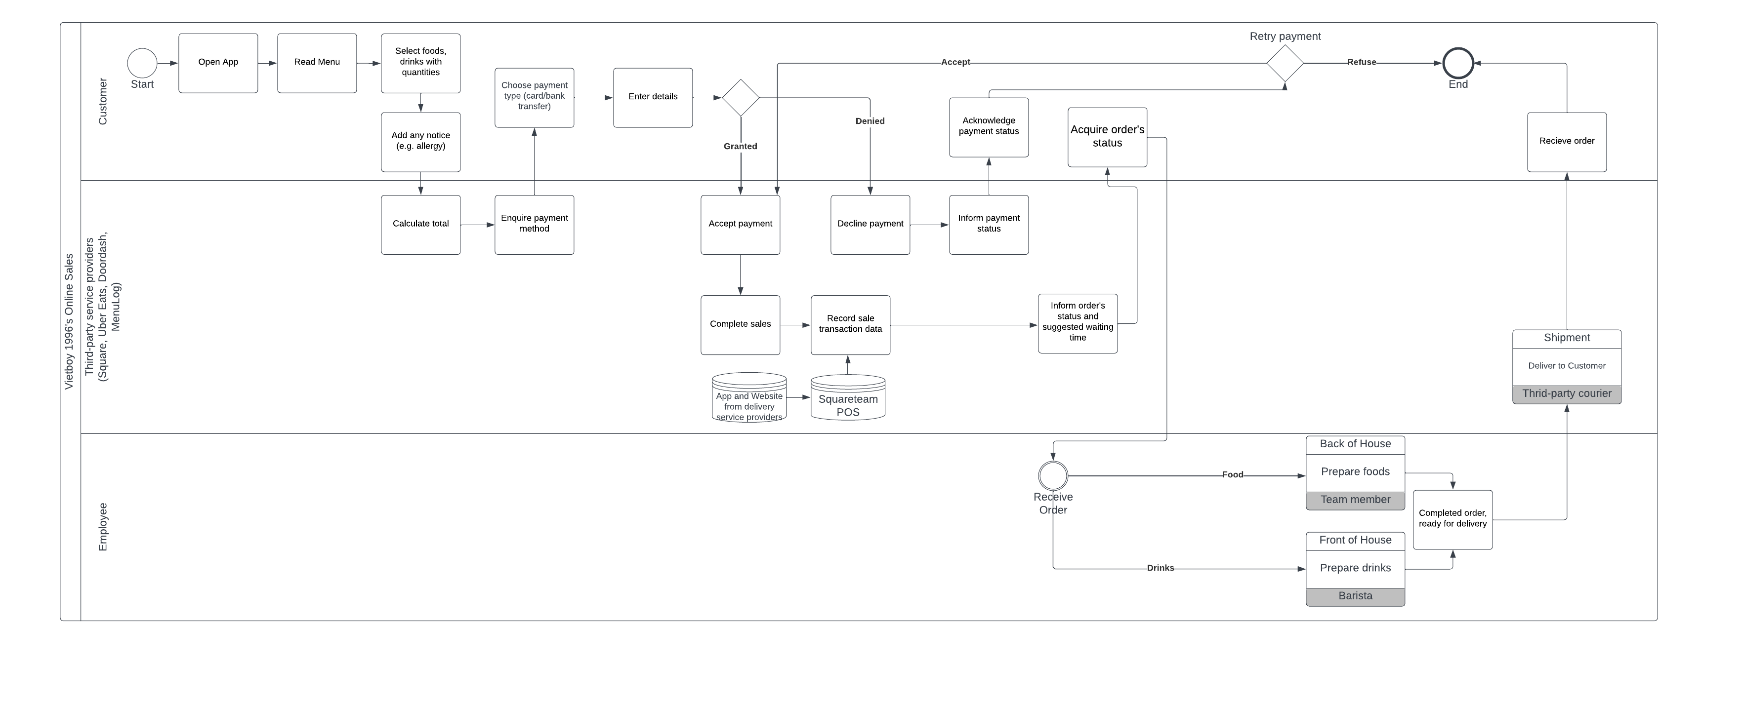
Process Model

Slide 5
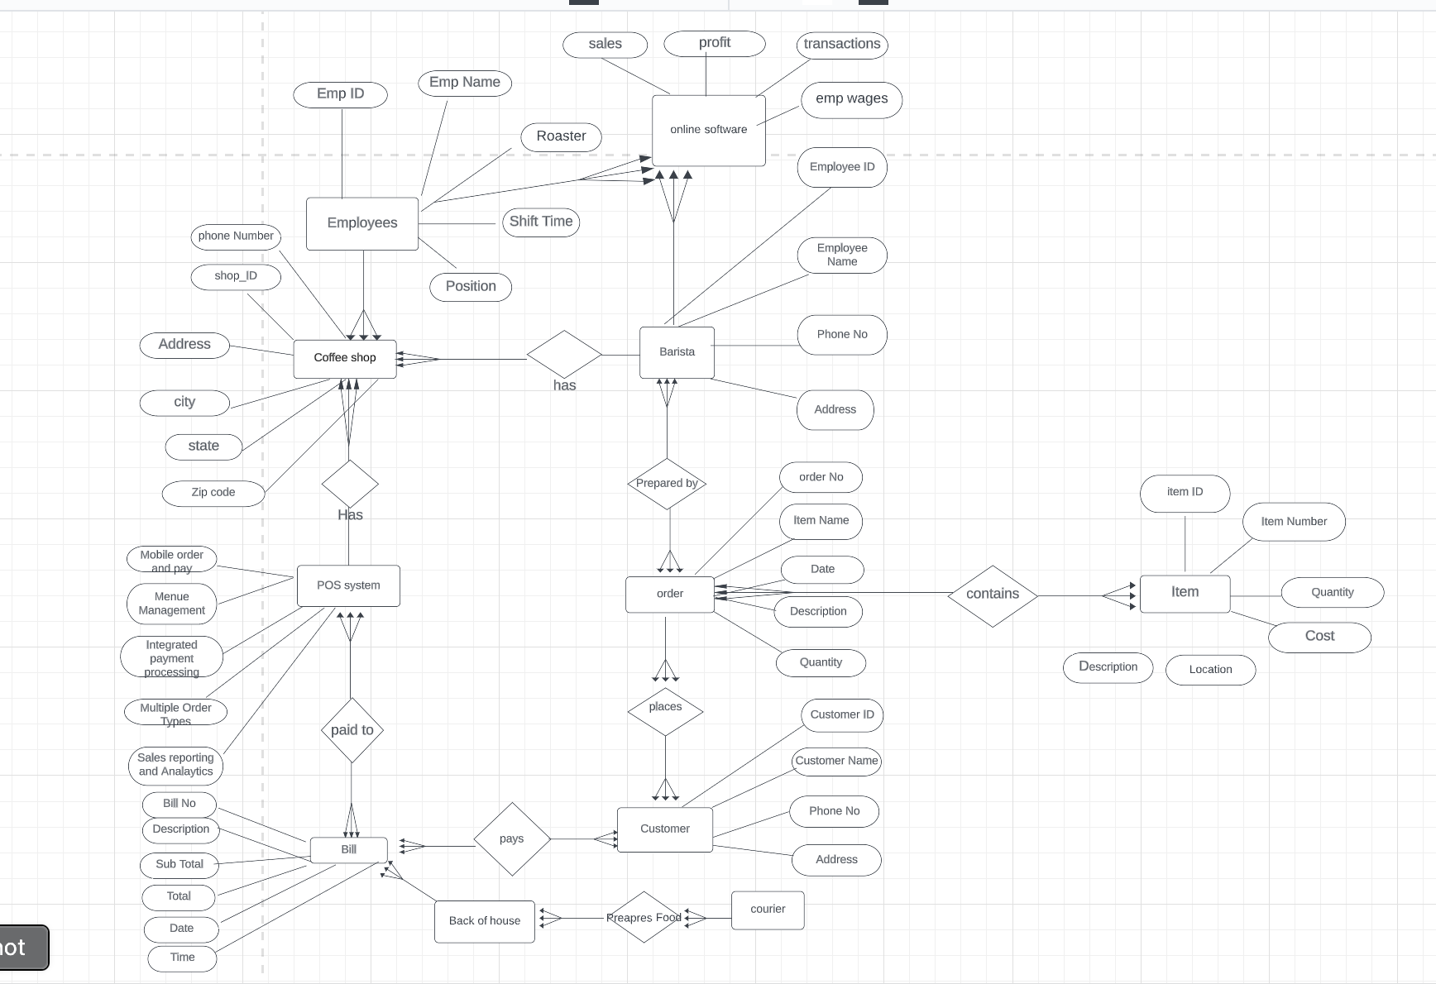
Data Data in terms of entities, attributes, and relations - VIETBOY1996
 | Entities | Attributes | Relations
Customer | the individuals who purchase coffee and other products at the coffee shop. (Mostly Office workers ) | Name, contact information (phone, email, address), loyalty program membership, order history, payment preferences. | A customer can place many orders, but each order is placed by only one customer.
2. Employee | staff who work at the coffee shop, such as baristas, cashiers, and managers. | Name, position, contact information, schedule, hourly rate or salary, job performance metrics. | An employee can process many orders, but each order is processed by only one employee.
3. Product | different items sold at the coffee shop, such as coffee, tea, pastries, and snacks. | Name, price, description, ingredients, availability, expiration date. | A product can be sold in many orders, and each order can include many products.
4. Supplier | The businesses or individuals who provide the coffee shop with the products it sells, such as coffee beans, tea leaves, milk, and sugar. | Supplier: Name, contact information, products supplied, price, quality rating. | A supplier can provide many products to the coffee shop, and each product can be provided by many suppliers.
5. Order | the individual orders placed by customers, which may include one or more products. | Order number, date/time, customer name, employee who processed the order, product(s) ordered, total price, payment method. | An order can have one or more payments, but each payment is associated with only one order.
6. Payment | The different methods of payment accepted by the coffee shop, such as cash, credit/debit cards, and mobile payments. The POS system. | Payment method (cash, credit card, etc.), amount, date/time, transaction number, payment processor. | -
7. Loyalty Program | any loyalty program or rewards system offered by the coffee shop to encourage repeat customers and customer retention. | Membership level, points earned, points redeemed, rewards earned or available, expiration date. | A loyalty program member can place many orders and earn many points, but each order and each point is earned by only one member.
8. Location | This entity represents the physical location(s) of the coffee shop, which may include one or more branches or stores. | Address, phone number, hours of operation, store layout, seating capacity. | A coffee shop can have one or more locations, but each location is associated with only one coffee shop.
9. Equipment | This entity represents the different types of equipment used in the coffee shop, such as espresso machines, grinders, and blenders. | Manufacturer, model, age, maintenance schedule, repair history. | Equipment can be used in many orders or activities, but each order or activity uses only one piece of equipment.

Slide 6
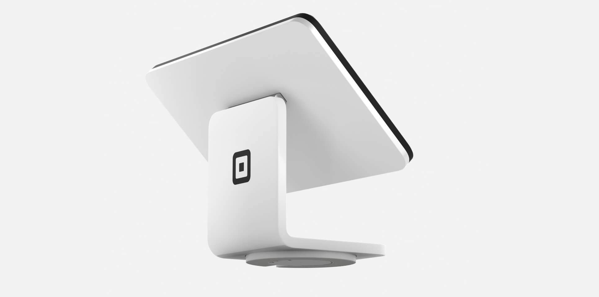
Externals
Vietboy1996 utilizes an external service made by Square to operate its sales, which is an example of outsourcing. Square is an external service provider that offers technology that helps small businesses to run everyday operations such as sales and inventory tracking. The external service Vietboy1996 uses is a POS system made by square which allows them to take payments from customers. This helps Vietboy1996 reduce errors from manual systems and improve efficiency and accuracy as payments go through an automated system.

Slide 7
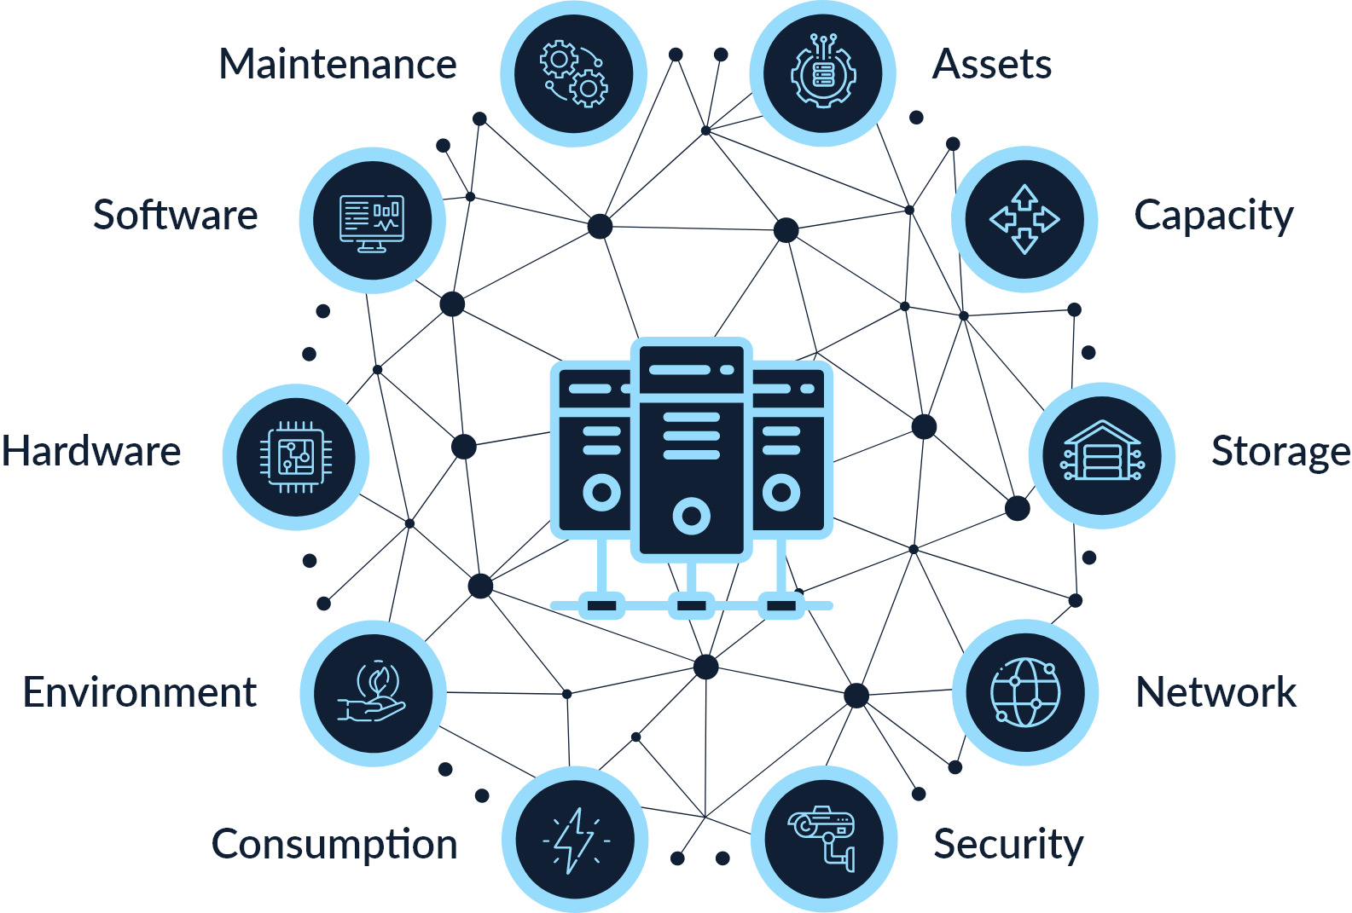
Technology Architecture
Unlike other well-constructed frameworks found elsewhere the software infrastructure initially starting from scratch, which enquires massive effort and technical expertise to overcome challenges.
Hence, in order to operate this software smoothly and efficiently, a proper technology architecture have to be well-considered.
Cloud computing
Software development
Database management
Payment gateway
Hardware and Network infrastructure

Slide 8
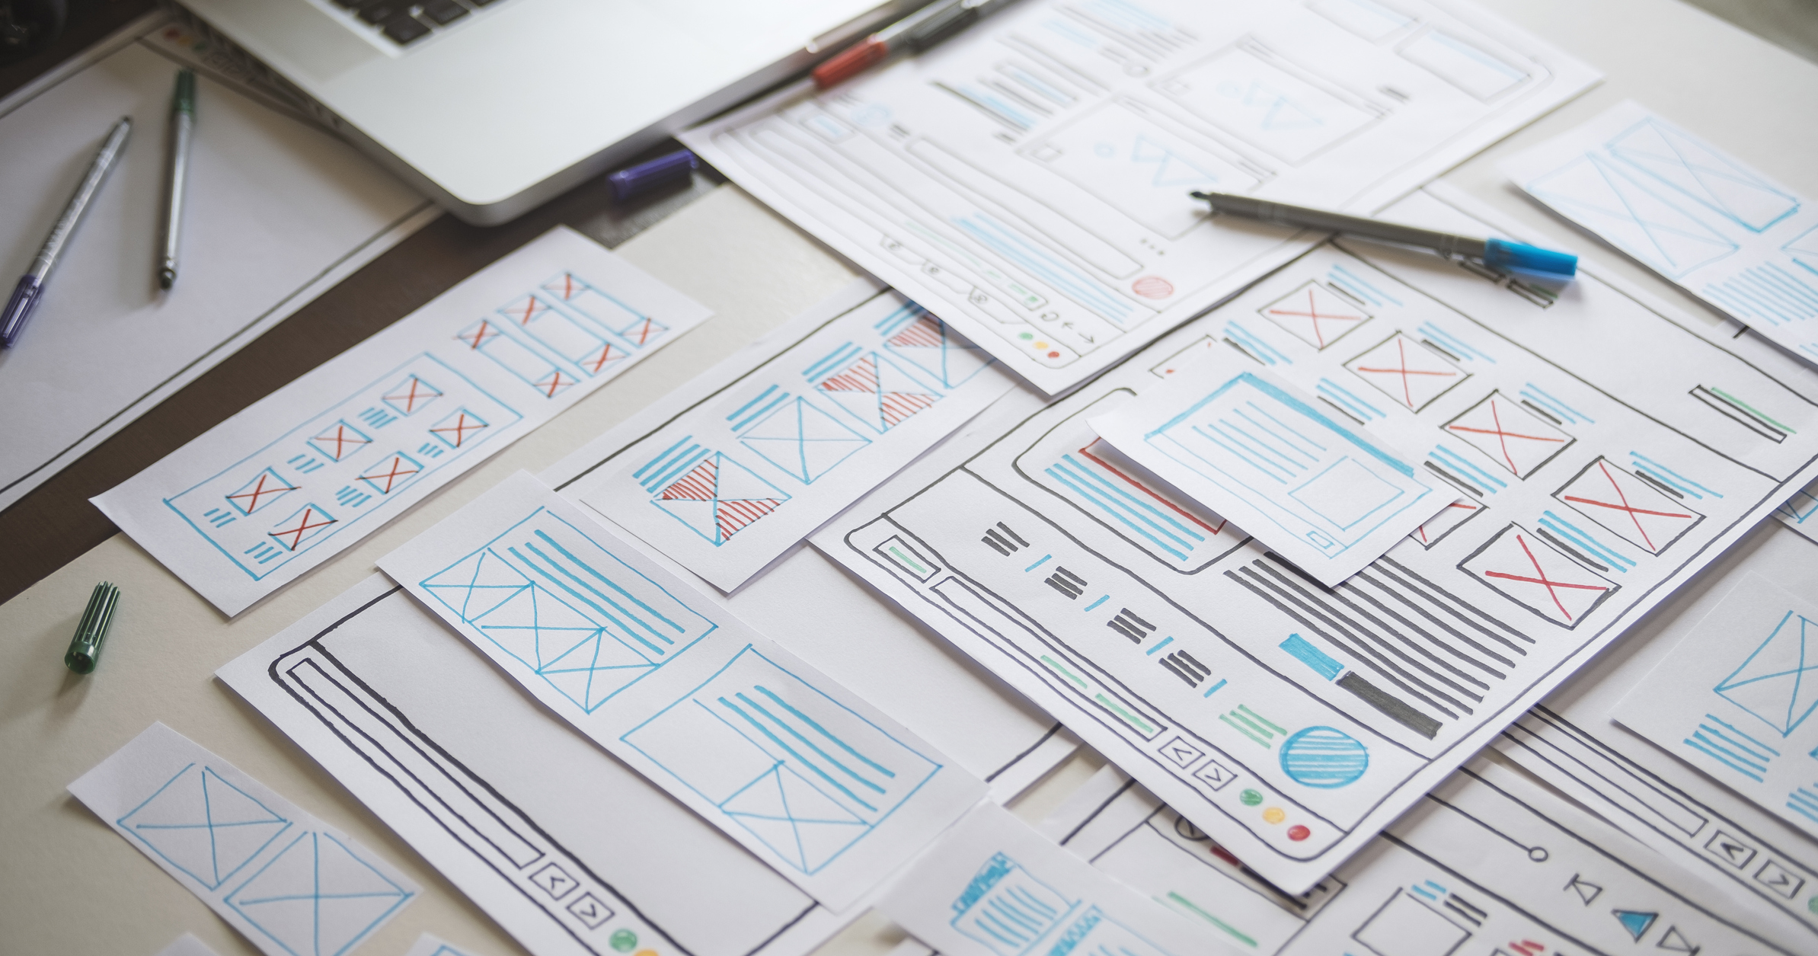
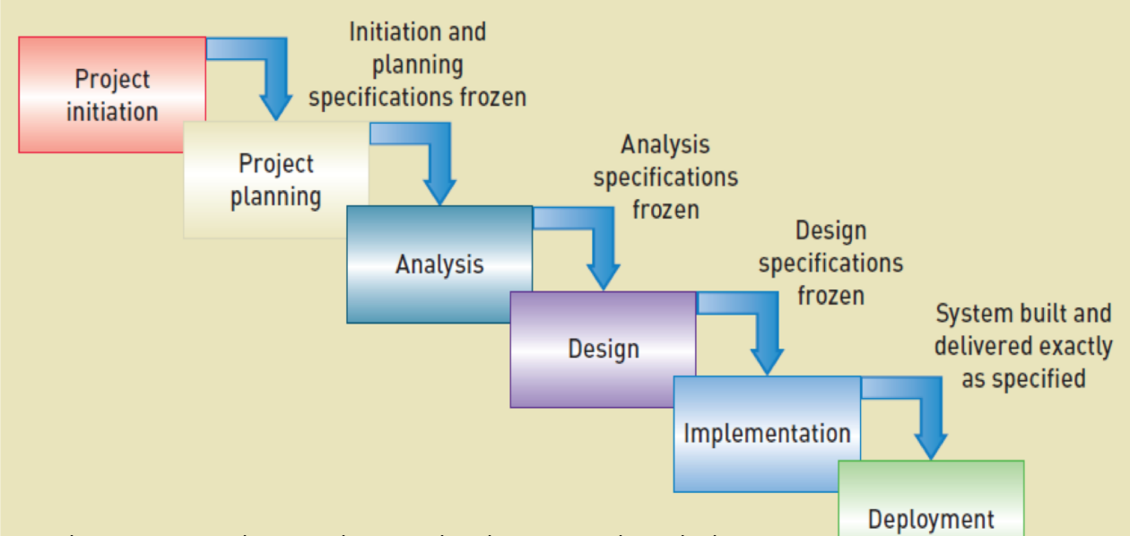
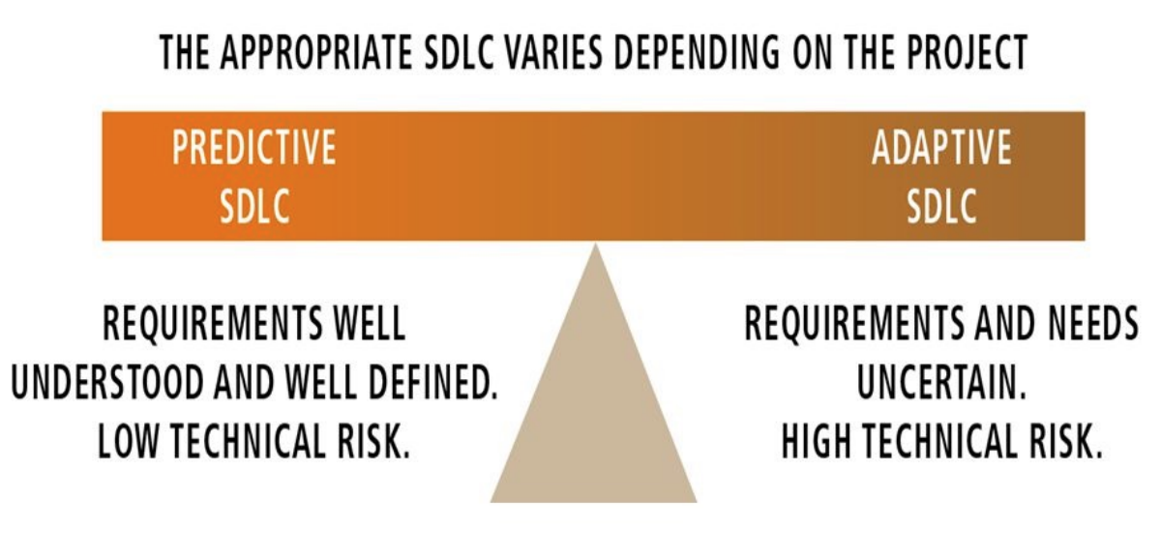
System Development Method

Slide 9
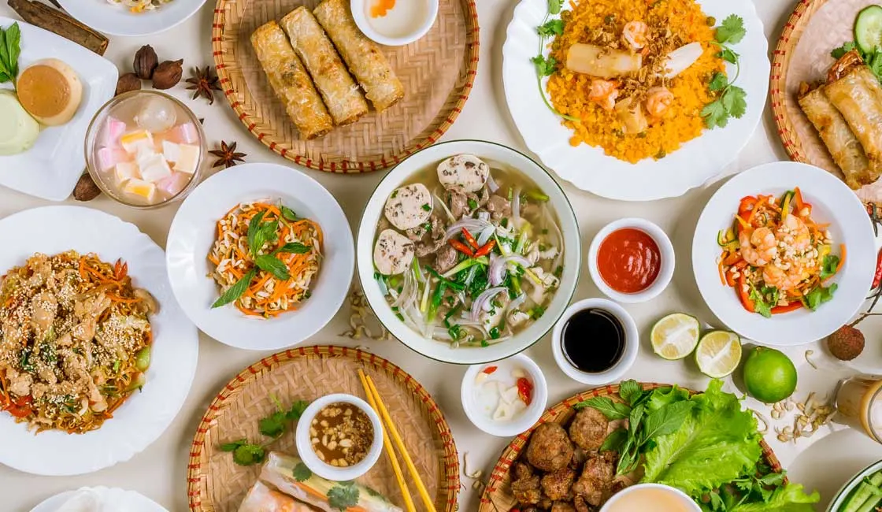
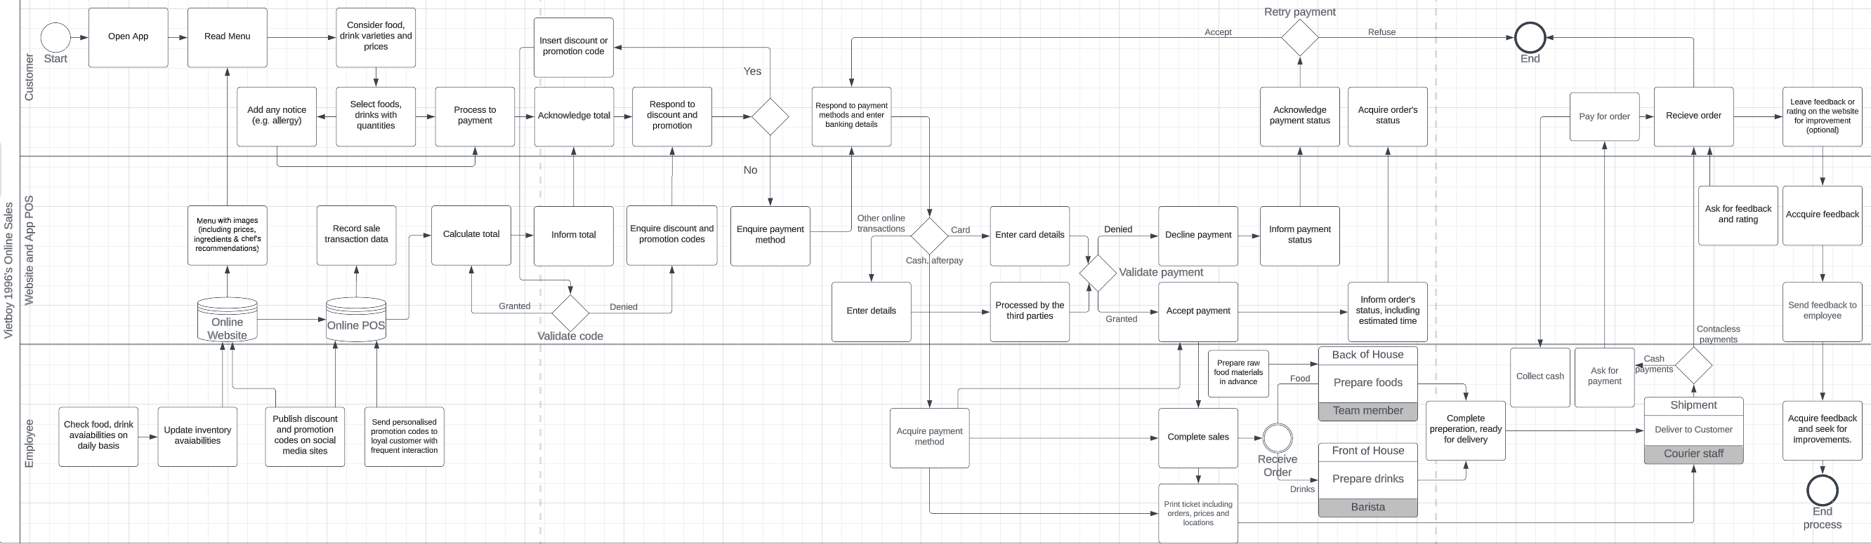
Improvement Opportunities and Threats
The store will undertake some rennovations in regard to their online sales model. There are numerous potential Opportunities and Threats regarding their renovation, shifting from its initial concept. Thus, we have to develop a strategical solution to resolve challenges that F&B businesses may have when digitalising their process.

Slide 10
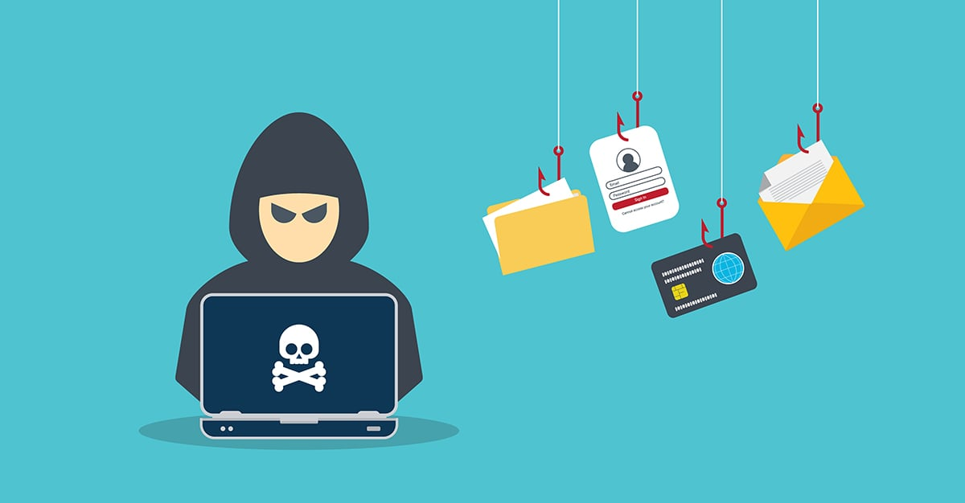
Ethics and Security
Some ethical and security concerns that may arise are the risk of cybercrime on Vietboy1996 customers when using the website. Some risks for customers can include location, phone number, credit card information and other sensitive information available when using the website, being stolen. This could raise concern if Vietboy1996 is not transparent about what they do with the information or how they keep it secure and away from the risk of cybercrime. A way for vietboy1996 to keep customer data secure is to hire an IT specialist who has the skills to make the system secure and can act when a cybercrime has been committed.

Slide 11
Conclusion
In conclusion, moving from a third-party sales model to a B2C model would help reduce unnecessary outgoing funds and ensure a higher revenue stream in the long run.

